Slide 1
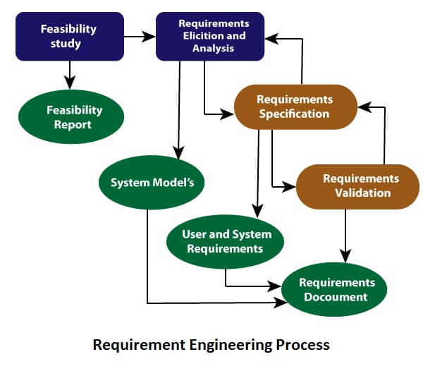
Requirement Engineering Process: Activities/ Steps

Slide 2
Requirement Engineering Process: Activities/ Steps
It is a four step process, which includes –
Feasibility Study
Requirement Elicitation
Software Requirement Specification
Software Requirement Validation

Slide 3
1. Feasibility study
Why feasibility study?
When the client approaches the organization for getting the desired product to be developed, it comes up with rough idea about what all functions the software must perform and which all features are expected from the software.
Referencing to this information, the Analyst does a detailed study about whether the desired system and its functionality are feasible to develop.
Notes:
Project managers use feasibility studies to discern the pros and cons of undertaking a project before they invest a lot of time and money into it.
Feasibility studies also can provide a company's management with crucial information that could prevent the company from entering blindly into risky businesses.

Slide 4
Feasibility study-Definition
Feasibility study is an analysis that takes all of a project's relevant factors into account:
Economic, technical, legal, and scheduling.
To ascertain the likelihood of completing the project successfully
Notes:
Information such as resource availability, cost estimation for software development, benefits of the software to the organization after it is developed and cost to be incurred on its maintenance are considered during the feasibility study.

Slide 5
Feasibility study-Objectives
Acceptable to users, adaptable to change and conformable to established standards.
Various other objectives of feasibility study are listed below:
• To analyze whether the software will meet organizational requirements-goals.
• To determine whether the software can be implemented using the current technology and within the specified budget and schedule.
• To determine whether the software can be integrated with other existing software.
Notes:
The objective of the feasibility study is to establish the reasons for developing the software that is acceptable to users, adaptable to change and conformable to established standards.

Slide 6
2. Requirements elicitation and analysis
If the feasibility report is positive towards undertaking the project, next phase starts with gathering requirements from the user.
Requirements gathering
Analysts and engineers communicate with the client and end-users to know their ideas on what the software should provide and which features they want the software to include.
Requirements analysis
Once requirements are gathered, the requirements are checked in detail- such as inconsistency, contradictions, omissions or defects
Notes:
requirements are identified with the help of customers and existing systems processes, if available. Analysis of requirements starts with requirement elicitation.

Slide 7
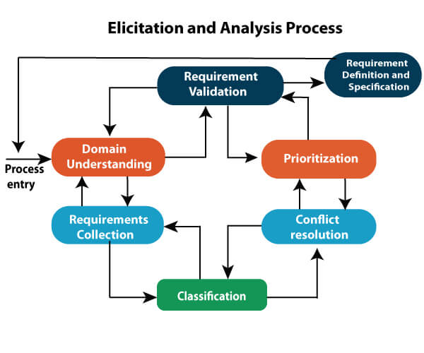

Slide 8
Problems of Elicitation and Analysis
Getting all, and only, the right people involved.
Stakeholders often don't know what they want
Stakeholders express requirements in their terms.
Stakeholders may have conflicting requirements.
Requirement change during the analysis process.

Slide 9
4. Software requirements specification
SRS is a document created by system analyst after the requirements are collected from various stakeholders (sources).
SRS defines how the intended software will interact with hardware, external interfaces, speed of operation, response time of system, portability of software across various platforms, maintainability, speed of recovery after crashing, Security, Quality, Limitations etc.
The requirements received from client are written in natural language. It is the responsibility of system analyst to document the requirements in technical language so that they can be comprehended and useful by the software development team.
Notes:
the requirement received by the customer written in ordinary language. It is the job of the analyst to write the requirement in technical language so that they can be understood and beneficial by the development team.

Slide 10
Software requirements specification
The models used at this stage include ER diagrams, data flow diagrams (DFDs), function decomposition diagrams (FDDs), data dictionaries, etc.
Data Flow Diagrams: DFD shows the flow of data through a system. The system may be a company, an organization, a set of procedures, a computer hardware system, a software system, or any combination of the preceding.
Notes:
Data Flow Diagrams (DFDs) are widely used for modeling the requirements.

Slide 11
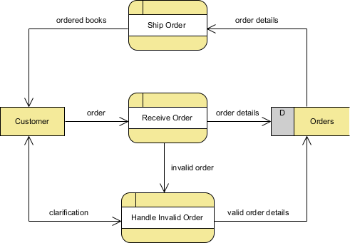
DFD Example-Online Bookstore
Notes:
Key Concepts of Data Flow Diagram-Process(eg. Process order), External Entity(Customer), Data Store(Database tables- inventory), Data Flow(Arrows)

Slide 12
Software requirements specification
Data Dictionaries: Data Dictionaries are simply repositories to store information about all data items defined in DFDs.
After each data object or item is given a descriptive name, its relationship is described.
The type of data, such as text or image or binary value, is described, possible predefined default values are listed and a brief textual description is provided. This data collection can be organized for reference into a book called a data dictionary.

Slide 13
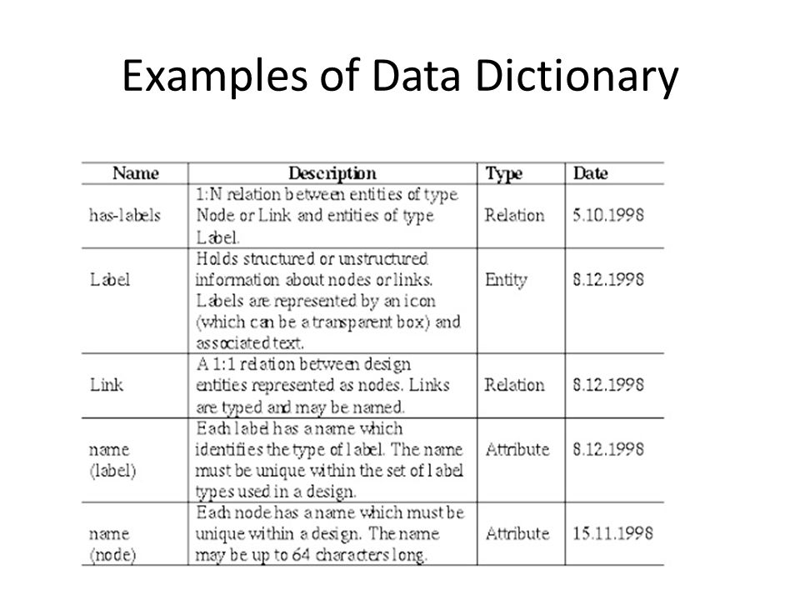

Slide 14
Software requirements specification
Entity-Relationship Diagrams: Another tool for requirement specification is the entity-relationship diagram, often called an "E-R diagram.
It is a detailed logical representation of the data for the organization and uses three main constructs i.e. data entities, relationships, and their associated attributes.

Slide 15
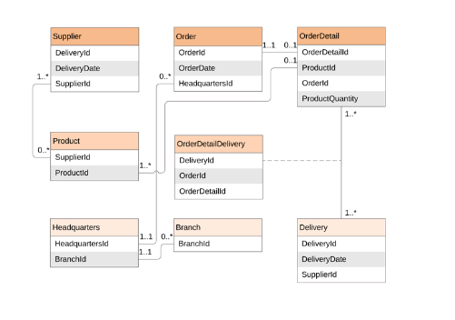
Notes:
Examples :One to One ----Login Form and Student
One to Many-----Student and Teacher
Many to Many ------ Customer and Product

Slide 16
Requirement validation- Review
User might ask for illegal, impractical solution or experts may interpret the requirements incorrectly.
This results in huge increase in cost if not nipped in the bud.
Requirements can be checked against following conditions :
If they can be practically implemented
If they are valid and as per functionality and domain of software.
If there are no any ambiguities
If they are complete
Notes:
After requirement specifications are developed, the requirements mentioned in this document are validated.

